Slide 1
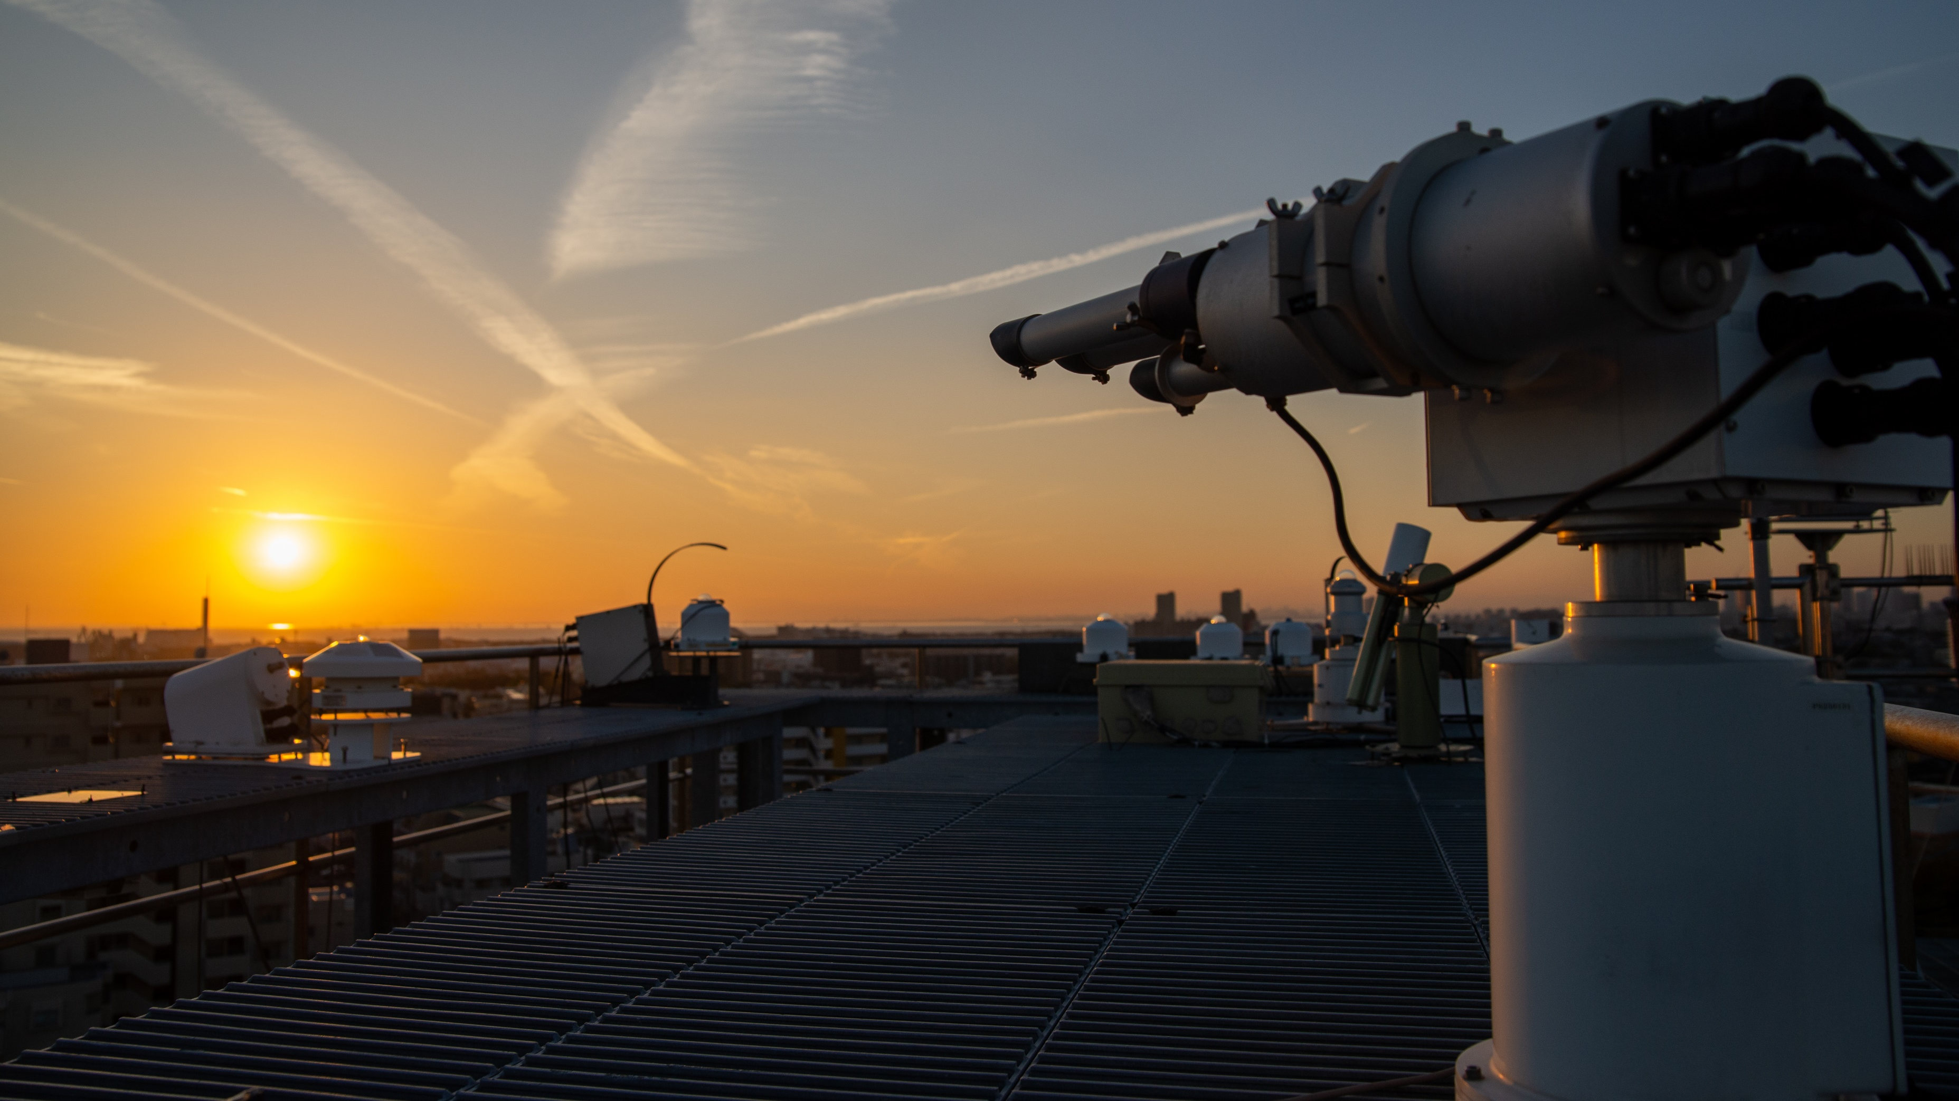
Chiba Campaign 2022
11/25~12/8
M2
Takeru OHNO

Slide 2
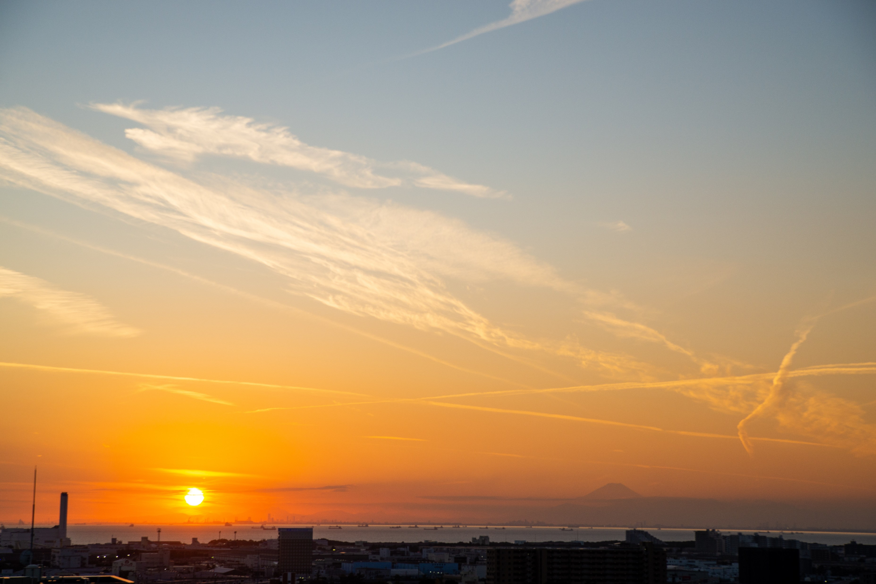
Mt. Fuji and Sunset

Slide 3
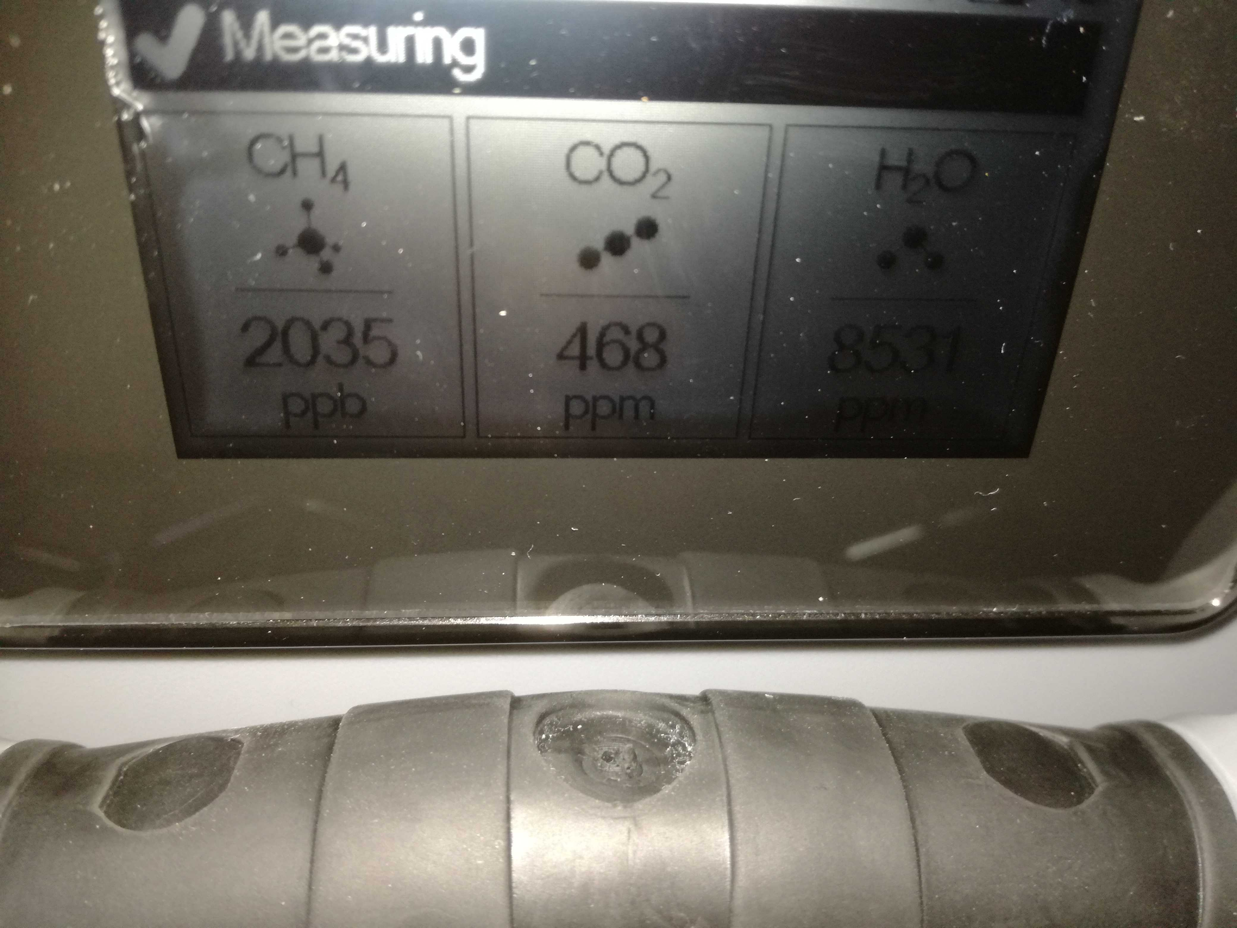
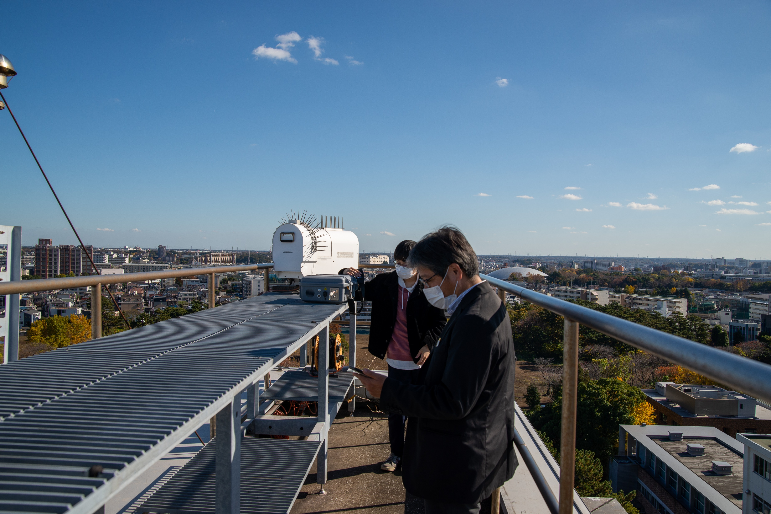
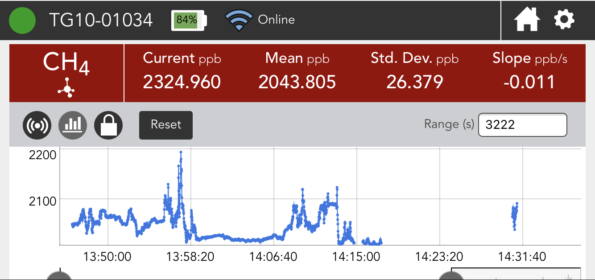
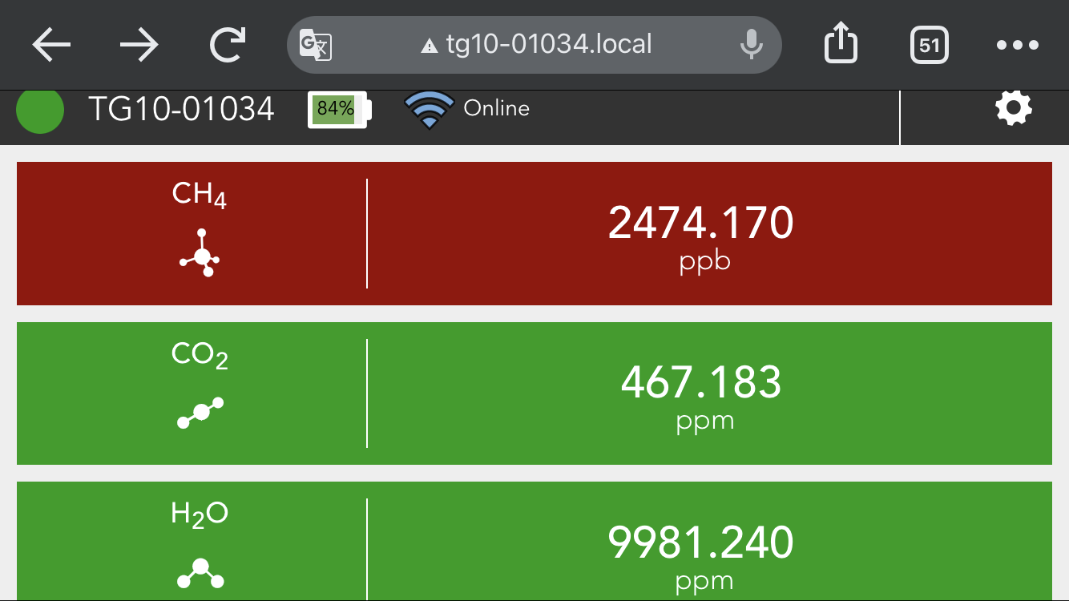
CH₄ Experiment
LI-7810
Instrument
CH₄変動要因に関する実験
Display
meiwafosis H.P.
Wi-Fi
Ethernet

